Slide 1

The (digital) Coptic Sahidic LXX as a contribution to a digital research ecosystem
Juan Garcés, Göttingen Centre for Digital Humanities
Symposium on Digital and Computational Scholarship in the Coptic Language
Humboldt University, Institute for German Language and Linguistics
14 May 2013

Slide 2

Editions in the print and digital eras
scholarly publication traditionally requires full documentation of sources, references and arguments, and allows – nay demands – the re-use of these sources and reference to previous editions in future publications on the same topic
text editions should only be seen as fully critical if all interpretative decisions that led to the text are made as fully accessible and transparent as possible
two conflicting principles: (1) the concrete and factual materiality of the extant documents that survive in libraries, archives and museums (2) the ideal and abstract notion of a reconstructed archetype of a “work”

Slide 3
Three definitions, one distinction
critical research
a discourse that seeks to make all interpretative decisions leading to critical knowledge as fully accessible and transparent as possible
digitized research
the acceleration of traditional (print-based) research through digital means
digital research
the pursuit of critical research making the most of digital approaches

Slide 4
Basic workflow
MS 1
MS 2
MS 3
Critically reconstructed text
Text witness 1
Text witness 2
Text witness 3

Slide 5
Basic workflow
Collation and text reconstruction
“Publication”
Assessment of pre-existing work
Marked-up transcription
Digital surrogates
Description/reconstruction of extant MSS

Slide 6
Standards and infrastructure
Unicode (Antinoou)
TEI-XML (exchange) http://insaph.kcl.ac.uk/iaph2007/iAph110055.html
Virtual environments for editing and research
WWW
Exchange protocols?

Slide 7
Place within the ecosystem
Digital stemmatology
Digital palaegraphy/codicology
Corpus-based research
Sahidic LXX
Coptic lexicography
Palaeographic/codicological database
Corpus of Sahidic literature
Scribal culture

Slide 8
Desiderata
Common shared vision (Open Source?)
Appropriate licensing models
Exchange standards/protocols

Slide 9


Slide 10
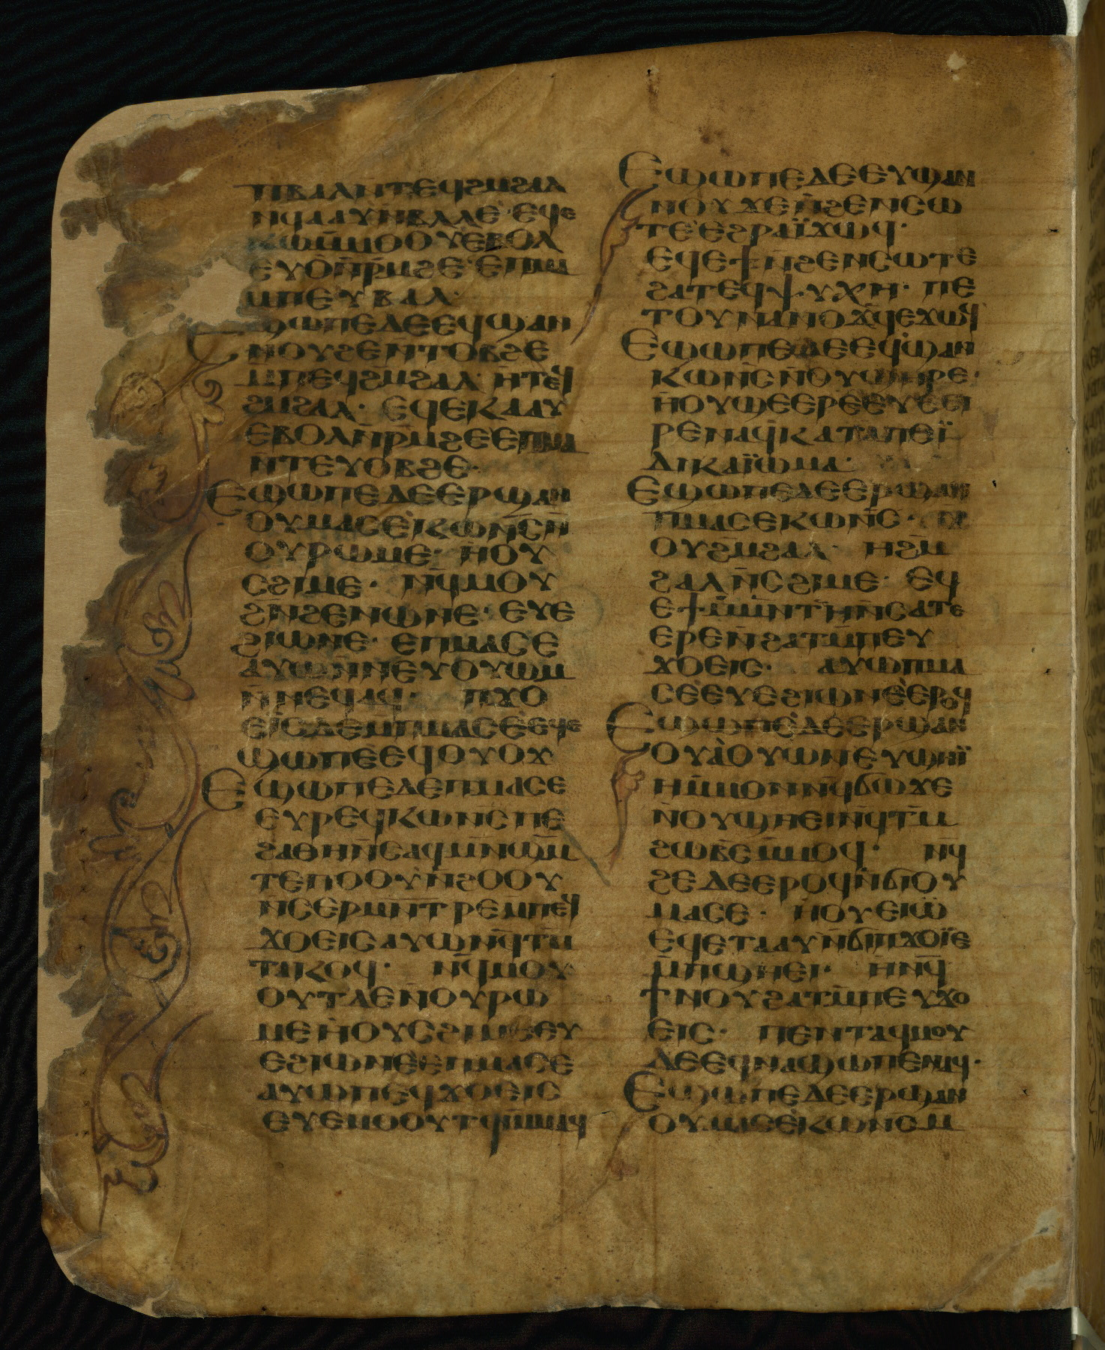
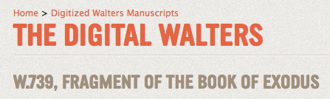
Walters Art Gallery, W. 739, f.1v = sa 181, p. 20
Ex 21:17-35
9./10. c.
White Monastery near Sohag

